Slide 1

PROJECT TUATARA
PROFESSOR : ROZSA ZARUBA
SHOCKERS :
NAGA SAINI VADDIRAJU (X799D523)
PRANEETH KORADA (E896E366)

Slide 2
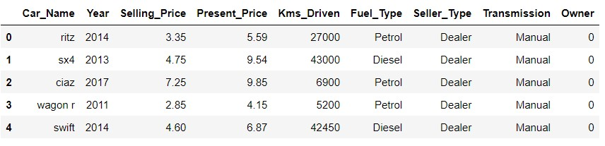
DATASET
I love bikes but you know, she said cars🤷‍♂️

Slide 3
ANALYSIS
Regression Models
Simple Linear Regression
Multiple Linear Regression
Comparing which regression gives better output.
What is the relationship between Selling price, Present price, Fuel type and Kms driven. And which variable is depending on what.
🚘 Let’s go…………..

Slide 4
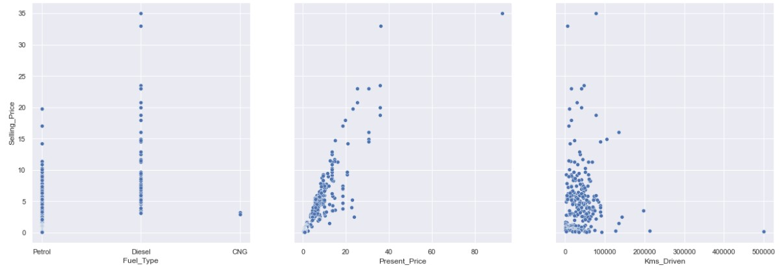
REGRESSION MODELS
Visualization Analysis of Simple Linear Regression

Slide 5
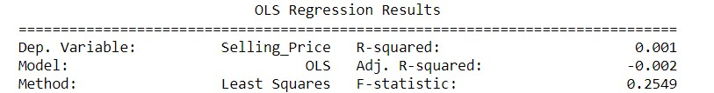
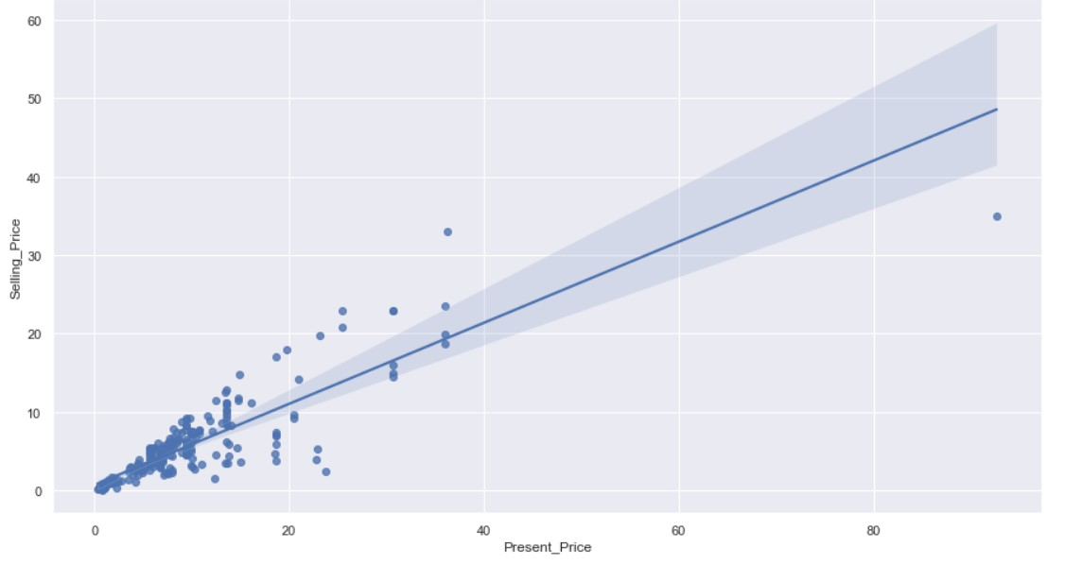
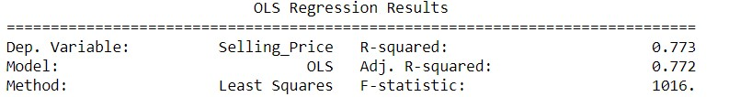
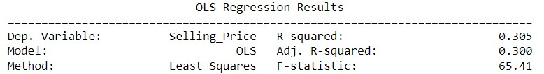
Selling_Price ~ Kms_Driven
Selling_Price ~ Present_Price
Selling_Price ~ Fuel_Type

Slide 6
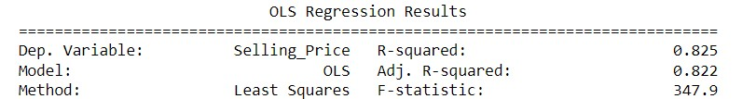
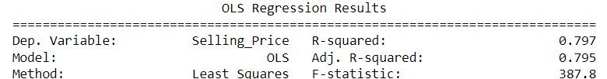
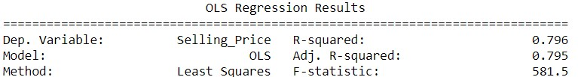
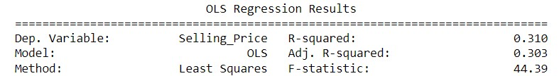
Multiple linear regression analysis:
Selling_Price ~ Fuel_Type + Present_Price +Kms_Driven
Selling_Price ~ Fuel_Type + Present_Price
Selling_Price ~ Present_Price +Kms_Driven
Selling_Price ~ Fuel_Type + Kms_Driven

Slide 7


Testing accuracy of simple linear regression = 74.7%
Testing accuracy of multiple linear regression = 77.9%

Slide 8

It’s okay
Multiple linear regression is better than me and simple linear regression.
BTW, I am Brownie 🐾

Slide 9
Questions?! 🤔
Nahh!! We are done. Have a great day🤪
PS: Thank you professor for your support.

